Slide 1
Digital Image Processing Technologies & Applications
Image Enhancement
(Point Processing)

Slide 2
What Is Image Enhancement?
Image enhancement is the process of making images more useful
The reasons for doing this include:
Making images more visually appealing
Removing noise from images
Highlighting interesting detail in images

Slide 3
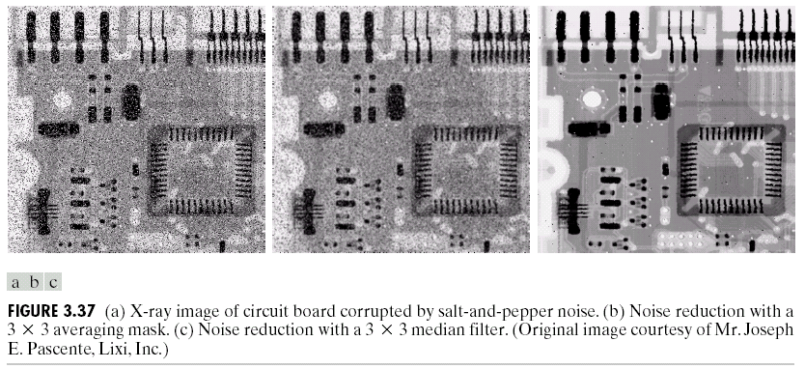
Image Enhancement Examples (cont…)

Slide 4
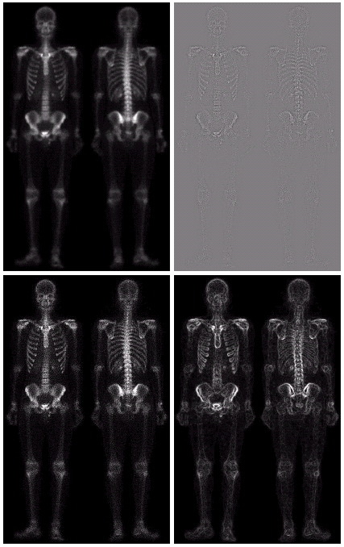
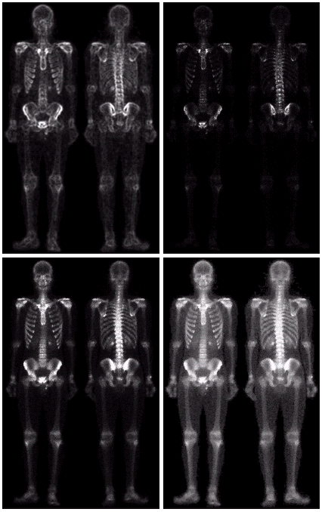
Image Enhancement Examples

Slide 5
A Note About Grey Levels
So far when we have spoken about image grey level values we have said they are in the range [0, 255]
Where 0 is black and 255 is white
For many of the image processing operations in this lecture grey levels are assumed to be given in the range [0.0, 1.0]

Slide 6
Spatial & Frequency Domains
There are two broad categories of image enhancement techniques
Spatial domain techniques
Direct manipulation of image pixels
Point processing
Neighbourhood operations
Frequency domain techniques
Manipulation of Fourier transform or wavelet transform of an image
For the moment we will concentrate on techniques that operate in the spatial domain

Slide 7
Basic Spatial Domain Image Enhancement
Most spatial domain enhancement operations can be reduced to the form
g (x, y) = T[ f (x, y)]
Origin
x
where f (x, y) is the input image, g (x, y) is the processed image and T is some operator defined over some neighbourhood of (x, y)
(x, y)
y
Image f (x, y)

Slide 8
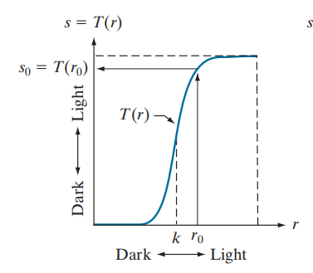
Basic Spatial Domain Image Enhancement
The simplest spatial domain operations occur when the neighbourhood is simply the pixel itself: Point Processing.
In this case T is referred to as a grey level transformation function or a point processing operation.
Point processing operations take the form:
s = T ( r )
where s refers to the processed image pixel value and r refers to the original image pixel value.

Slide 9
Basic Spatial Domain Image Enhancement
• Point processing
The neighborhood is of size 1×1
Gray-level transformation
• Mask processing or filtering
The neighborhood is defined as a mask, filter, or window.
Filtering

Slide 10
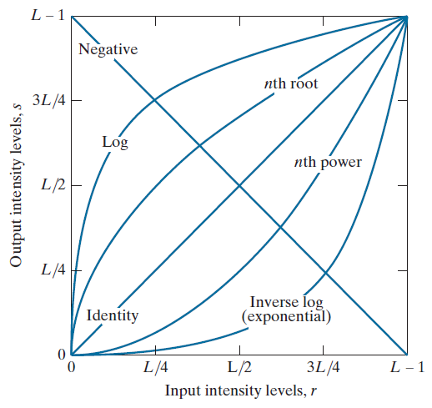
Point Processing
In this lecture we will look at image enhancement point processing techniques:
Thresholding
Logarithmic transformation
Power law transforms
Grey level slicing
Bit plane slicing
Image subtraction
Image averaging

Slide 11
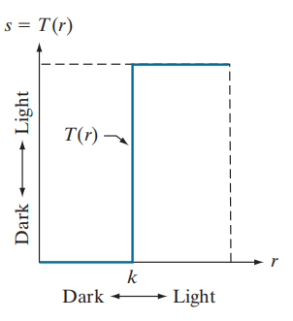
Thresholding
Thresholding transformations are particularly useful for segmentation in which we want to isolate an object of interest from a background.
1.0 r > threshold
s =
0.0 r <= threshold

Slide 12
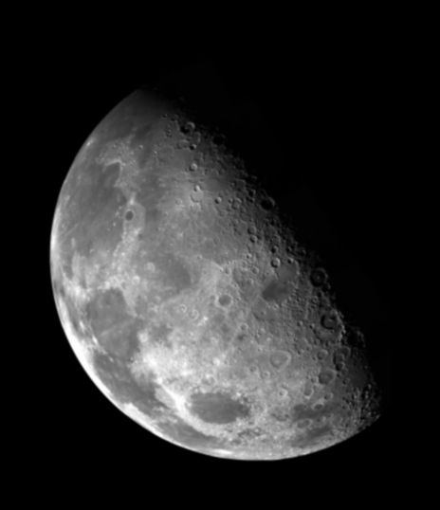

Thresholding
1.0
r > threshold
s =
0.0
r <= threshold

Slide 13
Logarithmic Transformations
The general form of the log transformation is
s = c * log(1 + r)
Log functions are particularly useful when the input grey level values may have an extremely large range of values.
In Fourier transform, we usually encounter spectrum values that ranges from 0 to 10⁶ or higher. But image display system cannot reproduce such a wide range of intensity values.

Slide 14
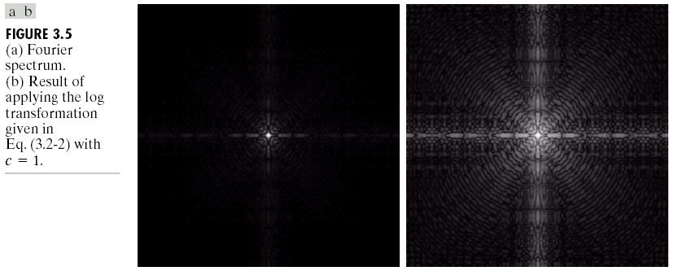
Logarithmic Transformations (cont…)
In the following example the Fourier transform of an image is put through a log transform to reveal more detail.
s = log(1 + r)
Example: logtransform.m

Slide 15
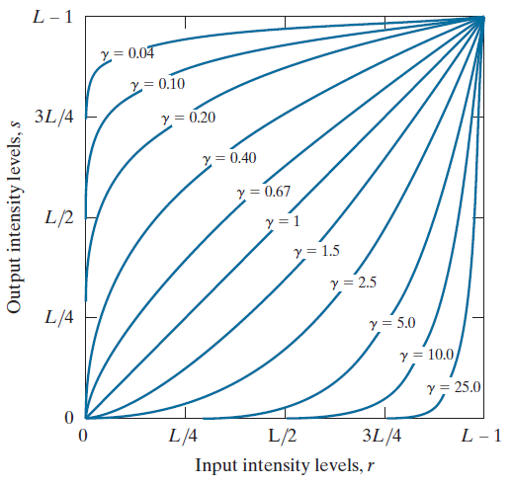
Power Law Transformations
Power law transformations have the following form:
s = c * r ^{γ} r ∈ [0.0, 1.0]
Map a narrow range of dark input values into a wider range of output values or vice versa.
Varying γ gives a whole family of curves.

Slide 16
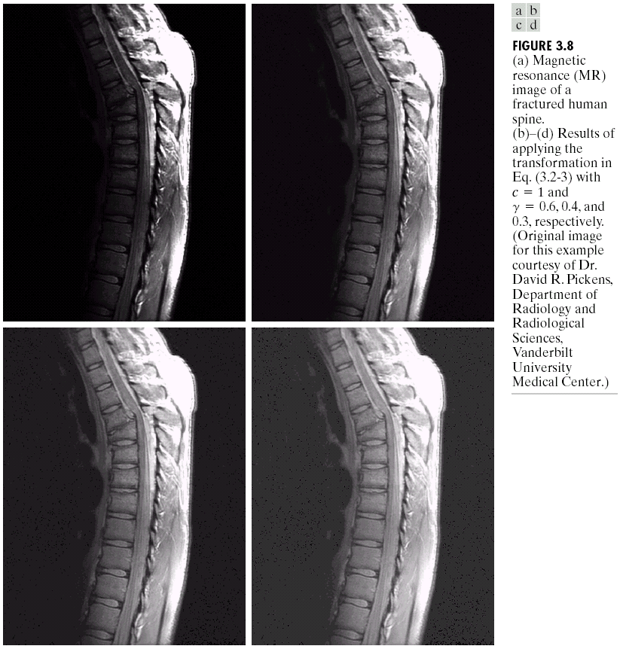
Power Law Example (cont…)
The images to the right show a magnetic resonance (MR) image of a fractured human spine.
Different curves highlight different detail.
s = r ^{0.6}
s = r ^{0.3}
s = r ^{0.4}
Exam: powertransform.m

Slide 17
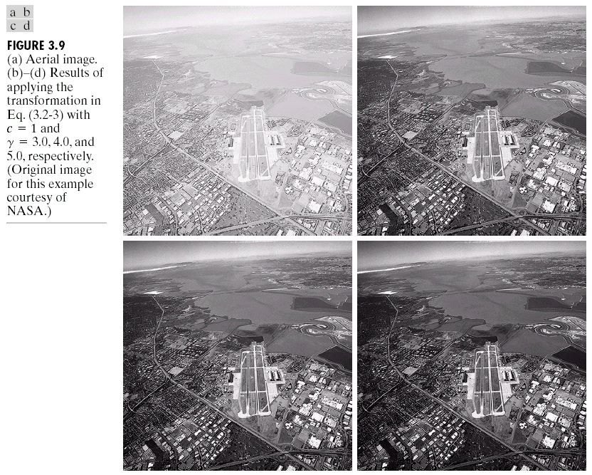
Power Law Transformations (cont…)
An aerial photo of a runway is shown.
This time power law transforms are used to darken the image.
s = r ^{3.0}
s = r ^{4.0}
s = r ^{5.0}
Exam: powertransform2.m
Notes:
aerial 航空的

Slide 18
Gamma Correction
Many of you might be familiar with gamma correction of computer monitors.
Problem is that display devices, print devices do not respond linearly to different intensities, and they respond according to a power law:
For CRT display, γ =1.8~2.5, LCD, γ =2.2.
Can be corrected using a nth root transform:
s = r ^{γ}
s = r ^{1/γ}

Slide 19
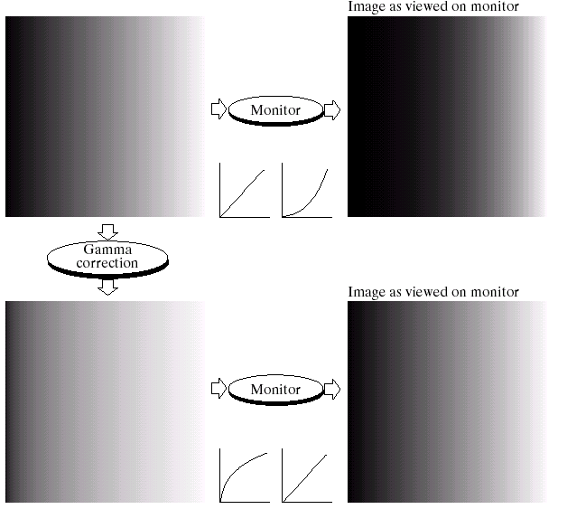
Gamma Correction
γ =2.5
γ =0.4

Slide 20
Gamma Correction
Prior Knowledge about gamma correction
Varying the value of gamma correction changes not only the brightness, but also the ratio of red to green to blue.
Applications
Internet
Millions of people and millions of monitors
Gamma represents an “average ”of the types of monitors and computer systems
Scanners, Printers have different values of gamma

Slide 21
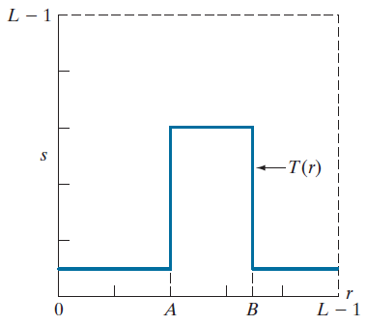
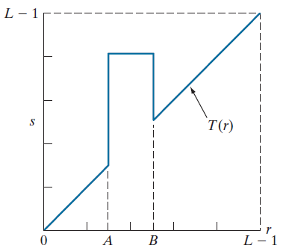
Gray Level Slicing
Highlights a specific range of grey levels
Similar to thresholding
Other levels can be suppressed or maintained
Useful for highlighting features in an image

Slide 22
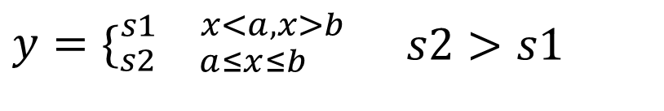
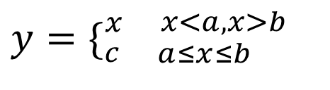
Gray Level Slicing
$$y=\{_{s2\begin{matrix} & a≤x≤b\end{matrix}}^{s1\begin{matrix} & x<a,x>b\end{matrix}}\begin{matrix} & s2>s1\end{matrix}$$
$$y=\{_{c\begin{matrix} & a≤x≤b\end{matrix}}^{x\begin{matrix} & x<a,x>b\end{matrix}}$$

Slide 23


Gray Level Slicing
a=210;
b=240;
I=find(x<a);
y(I)=0;
I2=find(x>b);
y(I2)=0;
I3=find(x>=a & x<=b);
y(I3)=255;
a=210;
b=240;
y=x;
I3=find(x>=a & x<=b);
y(I3)=255;
Exam: grayslicing.m

Slide 24
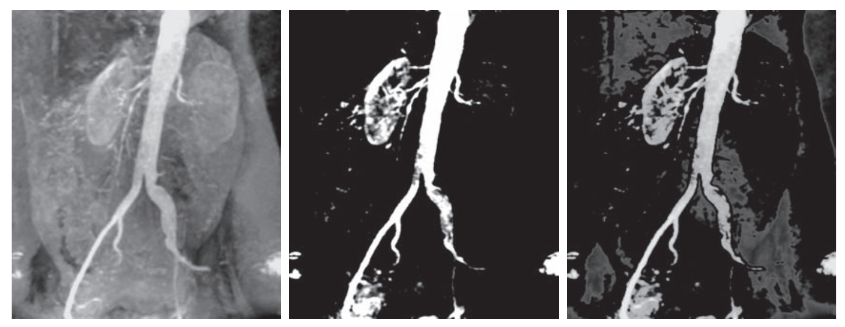
Gray Level Slicing

Slide 25
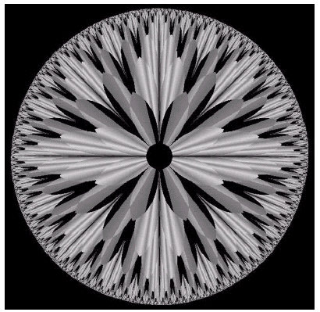
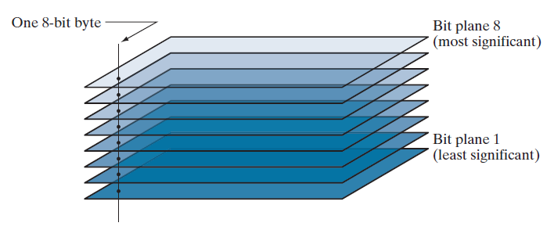
Bit Plane Slicing
Often by isolating particular bits of the pixel values in an image we can highlight interesting aspects of that image:
Higher-order bits usually contain most of the significant visual information.
Lower-order bits contain subtle details.
Notes:
比特平面分层

Slide 26
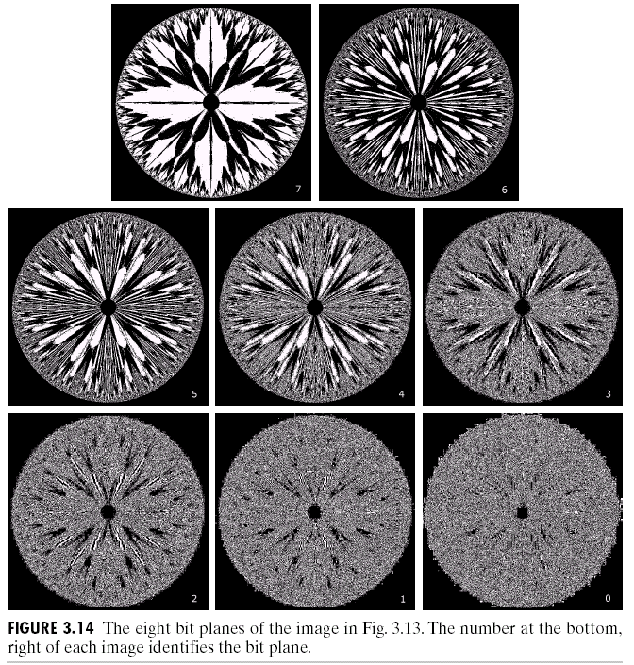
Bit Plane Slicing (cont…)
[10000000]
[01000000]
Exam: Bitplaneslicing.m
[00100000]
[00001000]
[00000100]
[00000001]

Slide 27
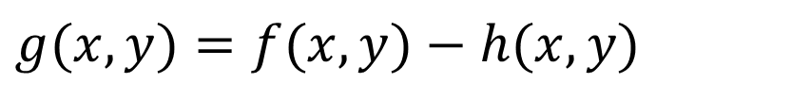
Image Subtraction
$$g(x,y)=f(x,y)−h(x,y)$$
f and h are two images.
Note: most images are displayed using 8 bits (even 24-bit color images consists of three 8 bit channels). Thus we expect image values not to be outside the range from 0 to 255.
In subtraction, the results should be in the range -255 to 255. so some sort of scaling is required to display the results.
Add 255 and then divide by 2
y=x-min(x); z=y*255/max(y).

Slide 28
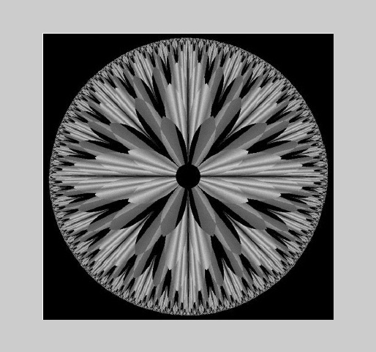
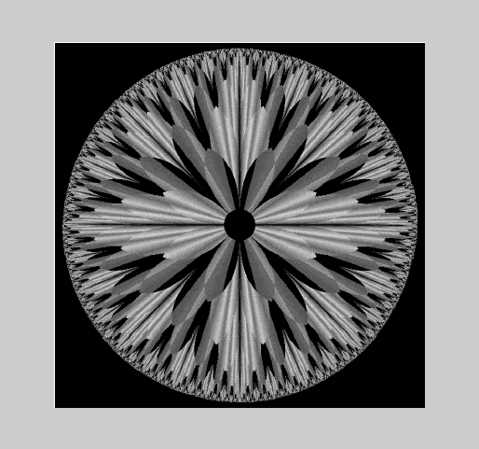
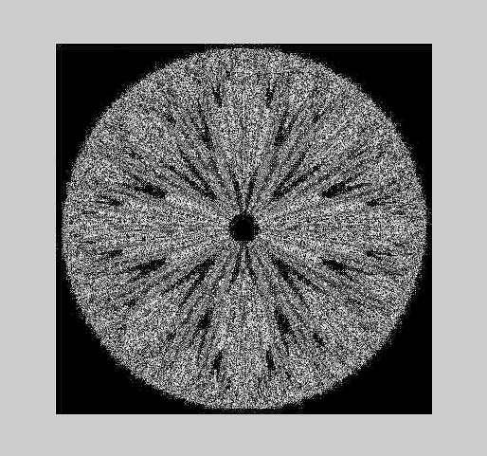
Image Subtraction
Exam: subtraction.m
Notes:
x-x1-x2-x3-x4

Slide 29
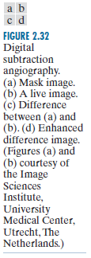
Image Subtraction
Mask mode radiography
h(x,y) is the mask

Slide 30
Image Subtraction
Change detection is another major application by using image subtraction. Such as:
Tracking moving vehicles
Tracking walking persons
Change detections

Slide 31
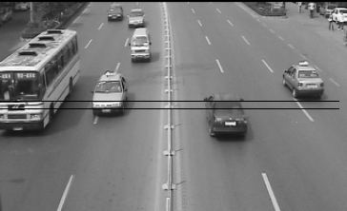
Image Subtraction

Slide 32
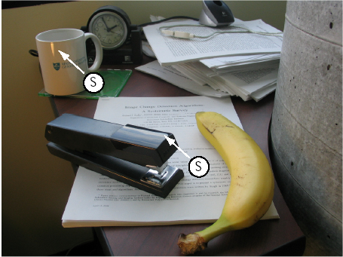
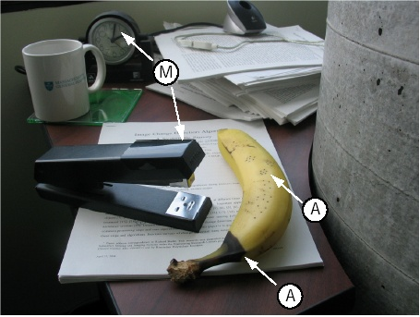
Examples: Change Detection

Slide 33
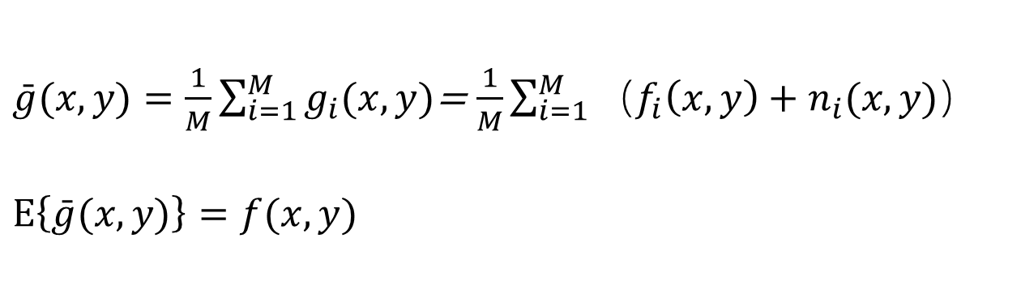
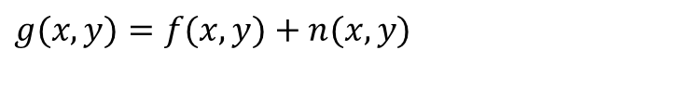
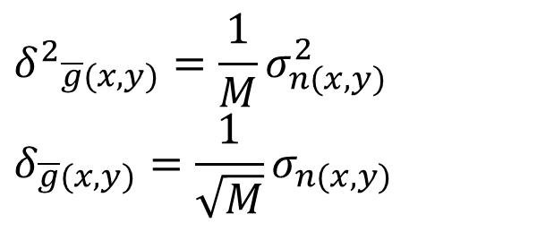
Image Averaging
A noisy image:
$$g(x,y)=f(x,y)+n(x,y)$$
Where n(x) is the noise, and it has zero average value. Then Averaging M different noisy images can reduce the noise:
$\bar{g}(x,y)=\frac{1}{M}\sum_{i=1}^{M}{g_{i}(x,y)}$= $\frac{1}{M}\sum_{i=1}^{M}{（f_{i}\left(x,y\right)+n_{i}(x,y)）}$ $$E\left\{\bar{g}(x,y)\right\}=f(x,y)$$
$${δ^{2}}_{\overline{g}(x,y)}=\frac{1}{M}σ_{n(x,y)}^{2} \\ δ_{\overline{g}(x,y)}=\frac{1}{\sqrt{M}}σ_{n(x,y)}$$

Slide 34
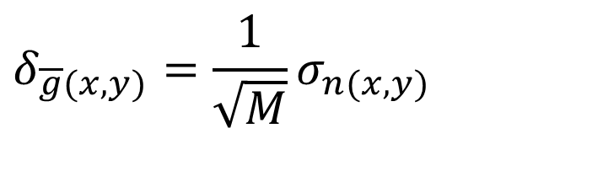
Image Averaging
As M increases, the variability of the pixel values at each location decreases.
This means that g(x,y) approaches f(x,y) as the number of noisy images used in the averaging process increases.
$$δ_{\overline{g}(x,y)}=\frac{1}{\sqrt{M}}σ_{n(x,y)}$$

Slide 35
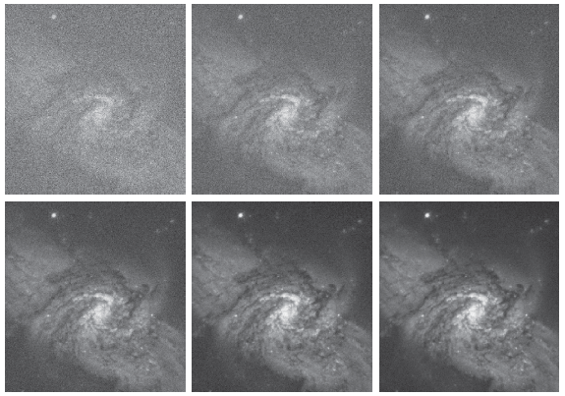
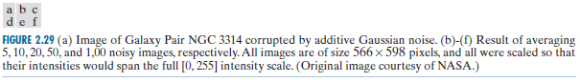
Image Averaging

Slide 36
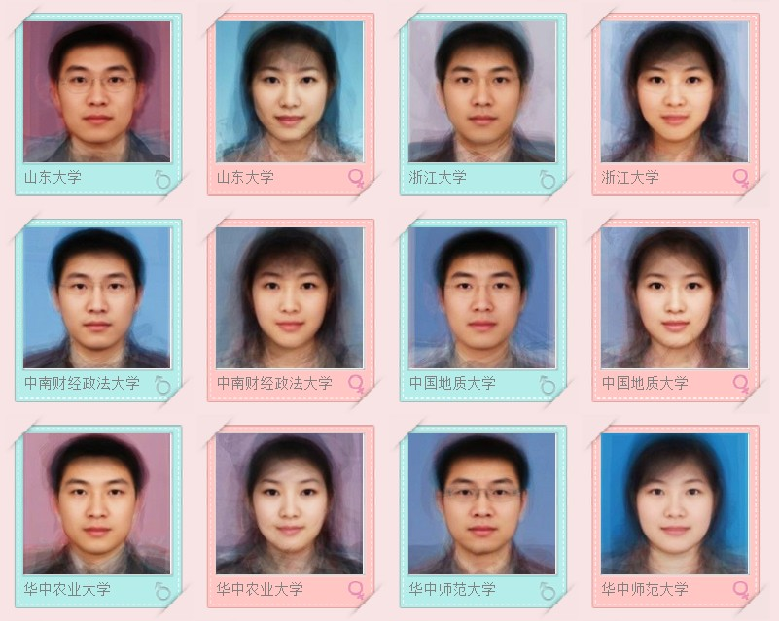
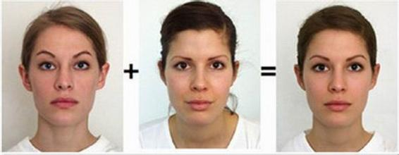
Image Averaging

Slide 37
Image Averaging
In average, the results of gray level should be in the range 0 to 255*M. so some sort of scaling is required to display the results.
Divide by M.
y=x-min(x); z=y*255/max(y).

Slide 38
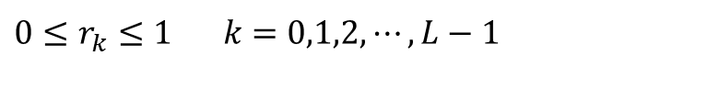
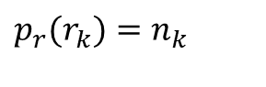
Image Histograms
The histogram of a digital image with gray levels from 0 to L-1 is a discrete function:
r_{k} is the kth gray level
n_{k} is the pixels in the image with that gray level
k = 0, 1, 2, …, L-1
Normalized histogram: p(r_{k})=n_{k}/n
n is the total number of pixels in the image
sum of all components is 1
$$p_{r}(r_{k})=n_{k}$$
$$0≤r_{k}≤{1^{}}_{}k=0,1,2,⋯,L−1$$

Slide 39
Image Histograms
The histogram of an image shows us the distribution of grey levels in the image. It is useful in image processing, especially in enhancement and segmentation.
1 | 2 | 3 | 4 | 5 | 6
5 | 4 | 5 | 6 | 2 | 14
5/36 | 4/36 | 5/36 | 6/36 | 2/36 | 14/36

Slide 40
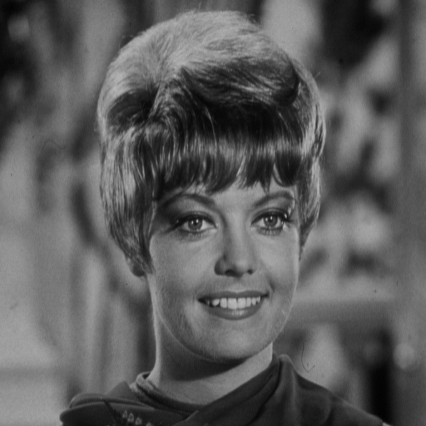
Image Histograms
MATLAB function > imhist(x)

Slide 41
Properties of Image Histograms
The histogram only shows the distribution of grey levels in the image, and it doesn’t include the location information of pixels.
One image has its corresponding histogram, but different images may have the same histograms.

Slide 42
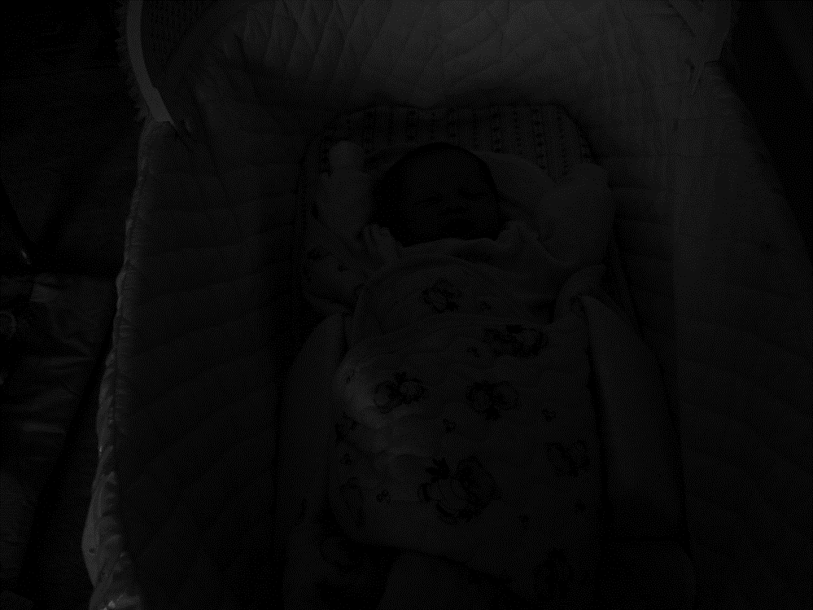
Image Histograms
It is a baby in the cradle!
Histogram information reveals that image is under-exposed

Slide 43
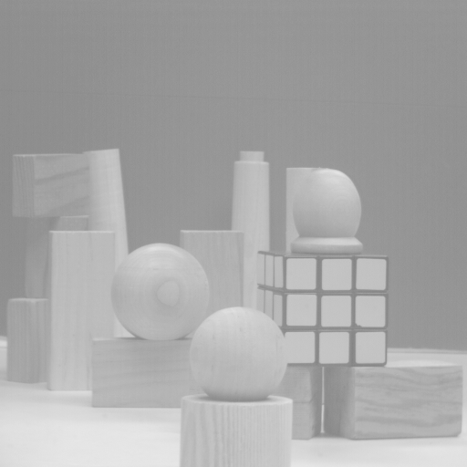
Image Histograms
Over-exposed image

Slide 44
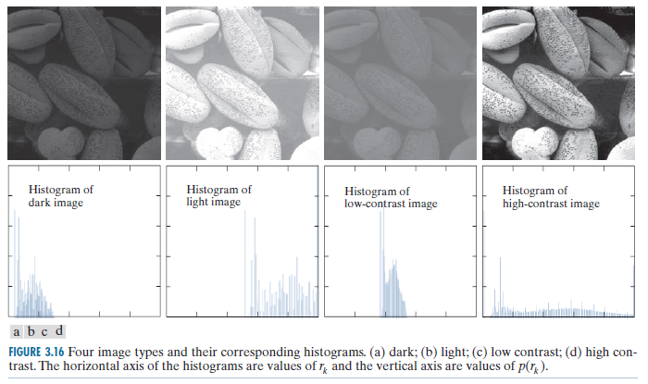
Histogram Examples
A selection of images and their histograms.
Notice the relationships between the images and their histograms.
Note that the high contrast image has the most evenly spaced histogram.

Slide 45
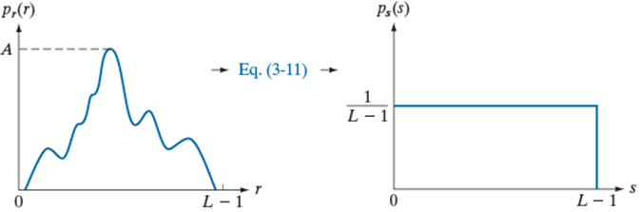
Histogram Equalization
Histogram equalization
Basic idea: find a map T(r) such that the histogram of the modified (equalized) image is flat (uniform).

Slide 46
Histogram Equalization
Consider for a moment continuous system, and let r represent the gray levels, which has been normalized to the interval [0,1], with r=0 representing black and r=1 representing white. For any r, define a transformation:
s=T( r )
That produce a level s for every pixel value r in the input image. We assume that the transformation function T(r) satisfies the following conditions:
(1) T(r) is single-value and monotonically increasing in the interval 0 ≤ r ≤ 1;
(2) 0 ≤ T(r) ≤ 1 for 0 ≤ r ≤ 1.

Slide 47
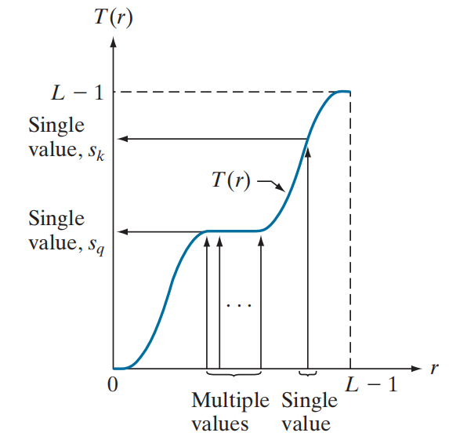
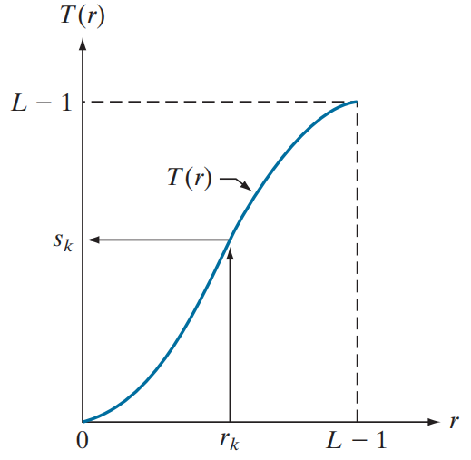
Histogram Equalization
T(r) is single-value and monotonically increasing in the interval 0 ≤ r ≤ 1;
0 ≤ T(r) ≤ 1 for 0 ≤ r ≤ 1.
The condition (1) preserves the increasing order from black to white in the output image.
The condition (2) guarantees that the output gray levels will be in the same range as the input levels.

Slide 48
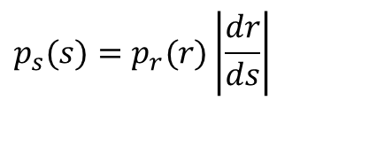
Histogram Equalization
Let p_{r}(r) and p_{s}(s) denote the probability density function of random variables r and s, respectively. A basic result from probability theory is that, if p_{r}(r) and T(r) are known and T⁻¹(s) satisfies condition (1). Then p_{s}(s) can be obtained using a rather simple formula:
$$p_{s}(s)=p_{r}(r)\left|\frac{dr}{ds}\right|$$
s=T(r),
Thus the probability density function (PDF) of s is determined by the gray level PDF of input image and by the chosen transformation function.
So for a given input image, we can change its histogram by some transformation, it is the idea of histogram equalization.

Slide 49
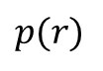
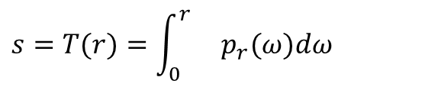
Histogram Equalization
Take the following equation as the transform function:
$$s=T(r)=\int_{0}^{r}{}p_{r}(ω)dω$$
This transform satisfy the two conditions:
（1）T(r) is single-value and monotonically increasing in the interval 0≤r≤1;
（2）0≤T(r)≤1 for 0≤r≤1.
Probability density functions are always positive. The integral of a function is the area under the function. So it should be single values and monotonically increasing.
Similarly, the integral of the probability density function for variables in the range [0,1] also in the range [0,1]
Frequency of
occurrence
$$p(r)$$
0
r
1
Intensities

Slide 50
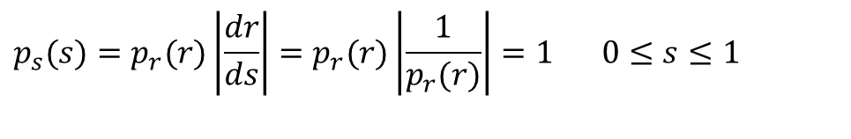
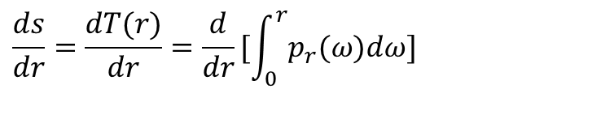


Histogram Equalization
$$\frac{ds}{dr}=\frac{dT(r)}{dr}=\frac{d}{dr}[\int_{0}^{r}{p_{r}(ω)dω}]$$
By Leibniz’s rule, we know that the derivative of a definite integral with respect to its upper limit is simply the integrand evaluated at the limit.
$$\frac{ds}{dr}=\frac{dT(r)}{dr}=\frac{d}{dr}[\int_{0}^{r}{p_{r}(ω)dω}]=p_{r}(r)$$
$$p_{s}(s)=p_{r}(r)\left|\frac{dr}{ds}\right|$$
$$p_{s}(s)=p_{r}(r)\left|\frac{dr}{ds}\right|=p_{r}(r)\left|\frac{1}{p_{r}(r)}\right|=1\begin{matrix} & \end{matrix}0≤s≤1$$

Slide 51

Histogram Equalization
It is important to note that T(r) depends on p_{r}(r), but the p_{s}(s) always is uniform, independent of the form of p_{r}(r).
So we can use p_{r}(r), as the transformation function to produce an output image which has an uniform distribution in histogram, that is called histogram equalization.
$$s=T(r)=\int_{0}^{r}{}p_{r}(ω)dω$$

Slide 52


Histogram Equalization
For discrete value we deal with probabilities and summations instead of probability density functions and integrals.
$$p_{r}(r_{k})={{\frac{n_{k}}{n}}^{}}_{}0≤r_{k}≤{1^{}}_{}k=0,1,⋯,l−1$$
Where n is the total number of pixels, n_{k} is the number of pixels that have gray level r_{k}, l is the total number of possible gray levels. p_{r}(r_{k}) is the probability of occurrence of gray level r_{k.}
$$s_{k}=T(r_{k})=\sum_{j=0}^{k}{p_{r}(r_{j})}={{{{\sum_{j=0}^{k}{\frac{n_{j}}{n}}}^{}}_{}}^{}}_{}0≤r_{j}≤{{{1^{}}_{}}^{}}_{}k=0,1,⋯,l−1$$

Slide 53


Histogram Equalization
Steps:
Find probability of the input image.
Find the cumulative distribution based on the probability.
Multiply cumulative values by the maximum gray-level value L-1 and round the results to obtain s_{k}.
Map the original gay-level value to the resulting value obtained in Step 3.
$$p_{r}(r_{k})=\frac{n_{k}}{n}$$
$${s^{′}}_{k}=T(r_{k})=\sum_{j=0}^{k}{p_{r}(r_{j})}$$

Slide 54

Histogram Equalization
An example, where the image is 64*64 pixels in size, with 8 grey levels. The distribution is as following table.

Slide 55


Histogram Equalization
Processing steps：
$$s_{0}=T(r_{0})=\sum_{j=0}^{0}{P_{r}(r_{j})}=P_{r}(r_{0})=0.19 \\ s_{1}=T(r_{1})=\sum_{j=0}^{1}{P_{r}(r_{j})}=P_{r}(r_{0})+P_{r}(r_{1})=0.44 \\ s_{2}=T(r_{2})=\sum_{j=0}^{2}{P_{r}(r_{j})}=P_{r}(r_{0})+P_{r}(r_{1})+P_{r}(r_{2})=0.65 \\ s_{3}=T(r_{3})=\sum_{j=0}^{3}{P_{r}(r_{j})}=P_{r}(r_{0})+P_{r}(r_{1})+P_{r}(r_{2})+P_{r}(r_{3})=0.81$$

Slide 56
Histogram Equalization
s₀=0.19，s₁=0.44， s₂=0.65， s₃=0.81，
s₄=0.89，s₅=0.95， s₆=0.98， s₇=1.0
The transform function is shown in (b).
Since the grey level is 8, and we should
adjust the output values to the nearest
integer numbers:
S0=0.19*7=1.33≈1; S1=0.44*7=3.08≈3;
S2=0.65*7=4.55≈5; S3=0.81*7=5.67≈6;
S4=0.89*7=6.23≈6; S5=0.95*7=6.65≈7;
S6=0.98*7=6.86≈7; S7=1*7=7.

Slide 57
Histogram Equalization
We can see that there are only 5 effective grey levels in the output image:
$$s_{0}≈1,_{}s_{1}≈3,_{}s_{2}≈5,_{}s_{3}≈6，s_{4}≈6,_{}s_{5}≈7,^{}s_{6}≈7{,_{}}_{}s_{7}≈7$$
r_{k} | n_{k} | P_{r} | s_{k} | n’_{k} | P_{s}
r₀=0 | 790 | 0.19 | s₀=1 | 790 | 0.19
r₁=1 | 1023 | 0.25 | s₁=3 | 1023 | 0.25
r₂=2 | 850 | 0.21 | s₂=5 | 850 | 0.21
r₃=3 | 656 | 0.16 | s₃=6 | 985 | 0.24
r₄=4 | 329 | 0.08 | s₄=6
r₅=5 | 245 | 0.06 | s₅=7 | 448 | 0.11
r₆=6 | 122 | 0.03 | s₆=7
r₇=7 | 81 | 0.02 | s₇=7

Slide 58
Histogram Equalization
Histogram of last table Transform function after equalization

Slide 59
Histogram Equalization
Before After
Image Example: histeq_demo.m

Slide 60
Histogram Equalization
before equalization
after equalization

Slide 61



Histogram Equalization

Slide 62


Equalisation Transformation Function
1

Slide 63

Equalisation Transformation Functions

Slide 64


Histogram Equalization
Before After

Slide 65
Summary
We have looked at:
Different kinds of point processing image enhancement
Histogram processing

